Slide 1

Perceived Risks and Benefits of Soft Robots

Slide 2
Perceived Risks and Benefits of Soft Robots
R 1: Do individuals assess soft robots more positively or negatively compared to conventional robots?
R 2: What are the most significant risks and benefits associated with soft robots in the two case studies of search and rescue and socially assistive soft robots? Focus on argument structures
R 3: What is the influence of demographic factors, particularly gender and age, on the positive or negative assessment of soft robots?

Slide 3
Study Design
Measuring risks and benefits
of soft robots
Philosophy
Psychology
Robotics
Background Information
Literature review on ethics and soft robots
Our focus RQ 2
RQ 2: qualitatively survey layperson perception on soft robots
RQ 1, 2, 3: quantitatively survey layperson perception on soft robots
search and rescue missions
Welcome and consent
Random assignment
Draw CAM
Adjust drawn CAM
Add information on soft robots
socially assistive
RQ additional?: qualitatively survey expert evaluation on risks and benefits
Expert evaluation on risks and benefits of soft robots within livMatS
Open question on risks and benefits of SR

Slide 4
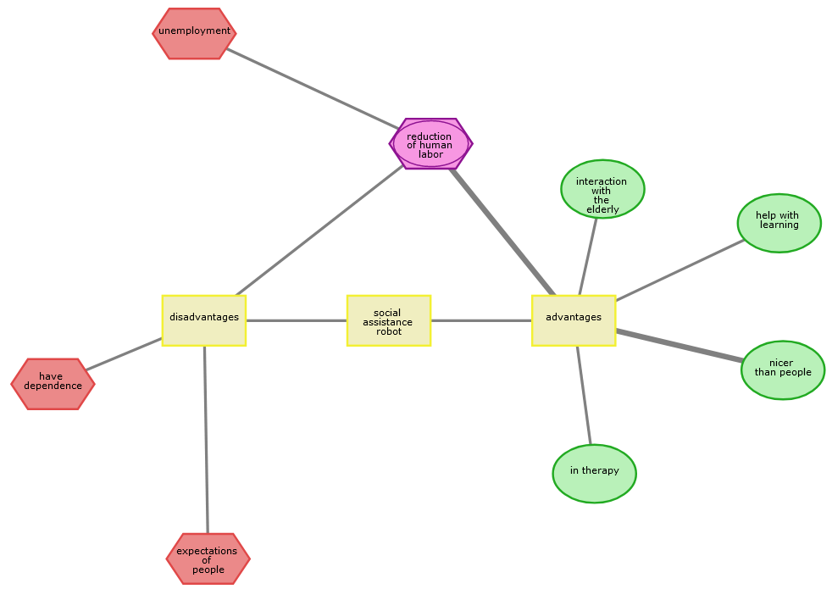
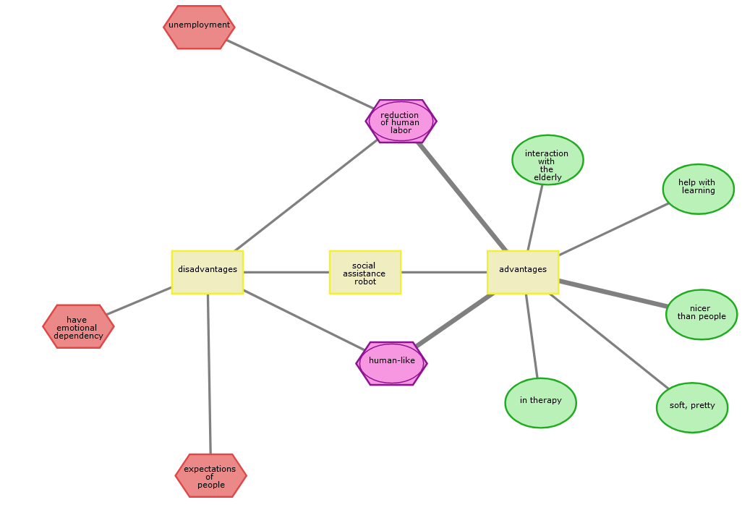
Intervention Design: Outcome
Draw CAM
Add information on soft robots
Adjust drawn CAM
Participant with ID: 6517299ba3d7cde45394692a

Slide 5
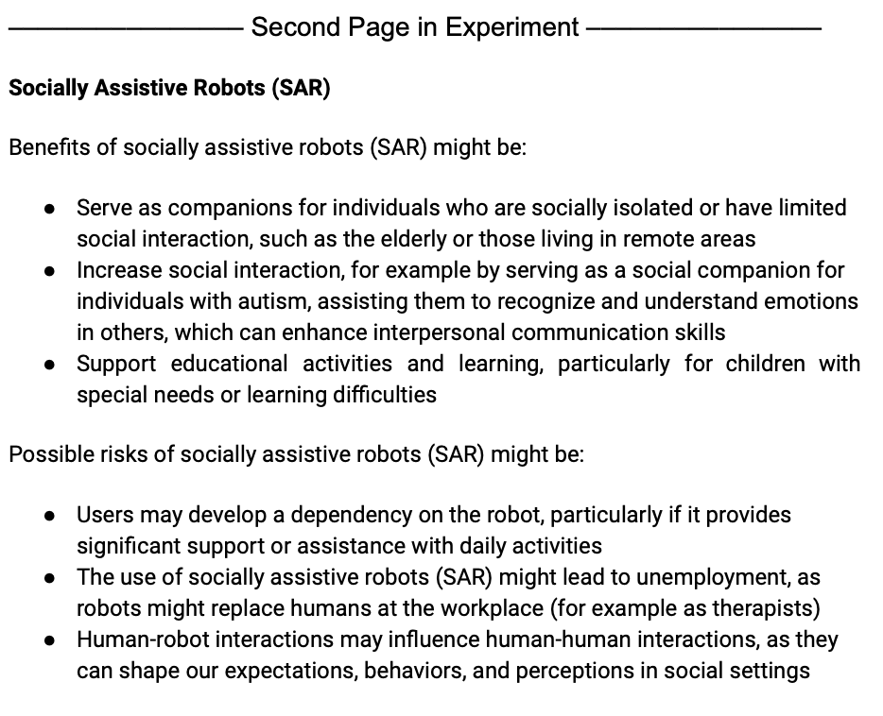
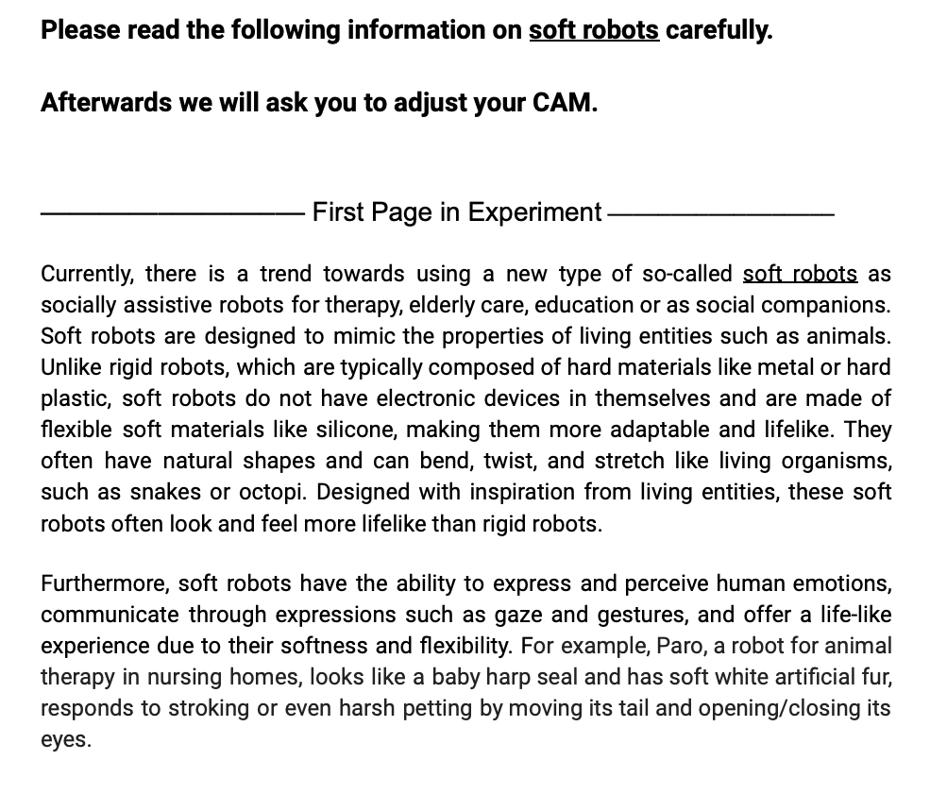
Informed by (scenario-based approach)
search and rescue missions
Information of rigid robots
Add information on soft robots
socially assistive

Slide 6
Results

Slide 7
Focus of results
RQ 2: qualitatively survey layperson perception on soft robots
RQ 1, 2, 3: quantitatively survey layperson perception on soft robots
RQ additional?: qualitatively survey expert evaluation on risks and benefits
R1: Perceived risks and benefits quantitative
R2: Perceived risks and benefits qualitative
R3: Perceived risks and benefits mediated by gender and age
Our focus RQ 2

Slide 8
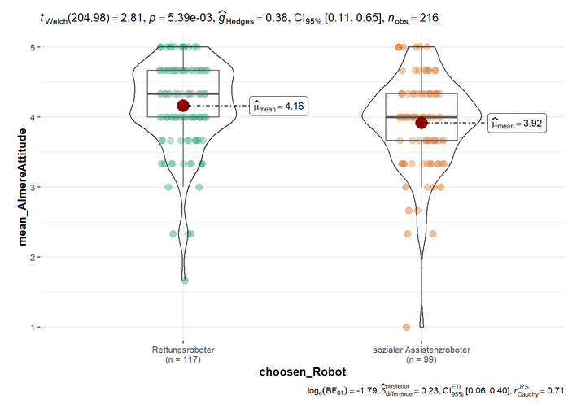
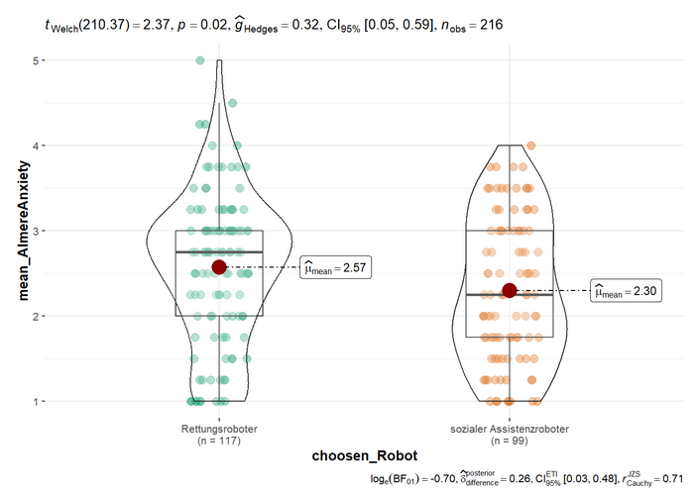
R1: Perceived risks and benefits quantitative: survey scales

Slide 9
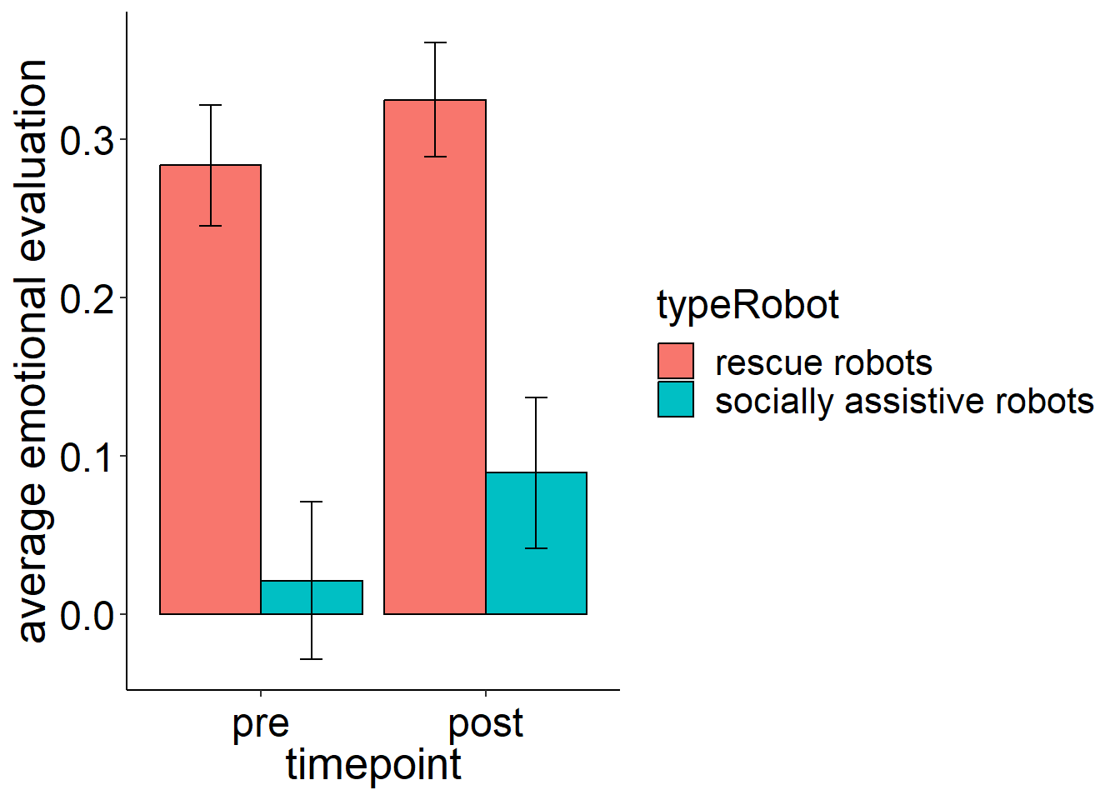
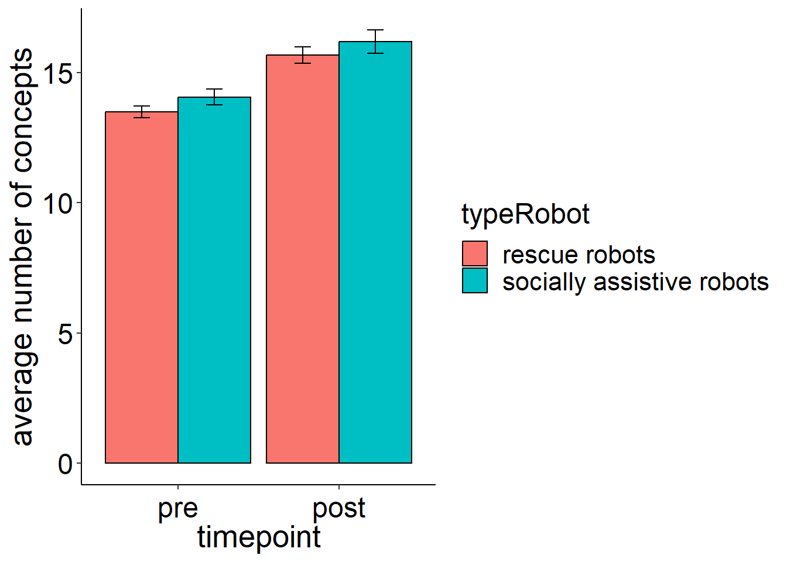
R1: Perceived risks and benefits quantitative: CAM network indicators
First results
(1) More positive assessment of soft robots compared to
rigid robots in both case studies
(2) More positive assessment of search and rescue soft robots
compared to socially assistive soft robots
(3) More concepts in post-CAMS (both case studies)

Slide 10
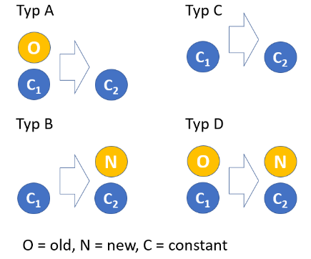
R2: Perceived risks and benefits qualitative: CAM semantic content
Draw CAM
Add information on soft robots
Adjust drawn CAM
Resulting types
A B C D
1 145 39 39
Only B, D added new concepts
Participant with ID: 6517299ba3d7cde45394692a

Slide 11
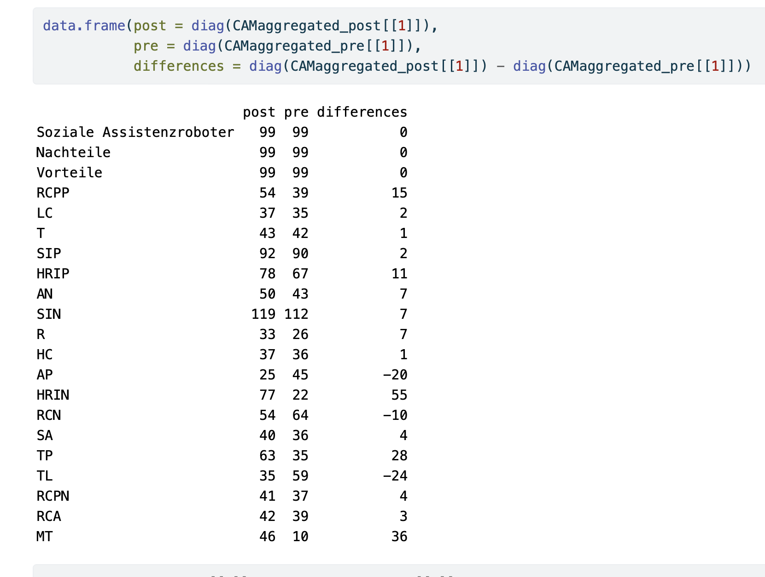
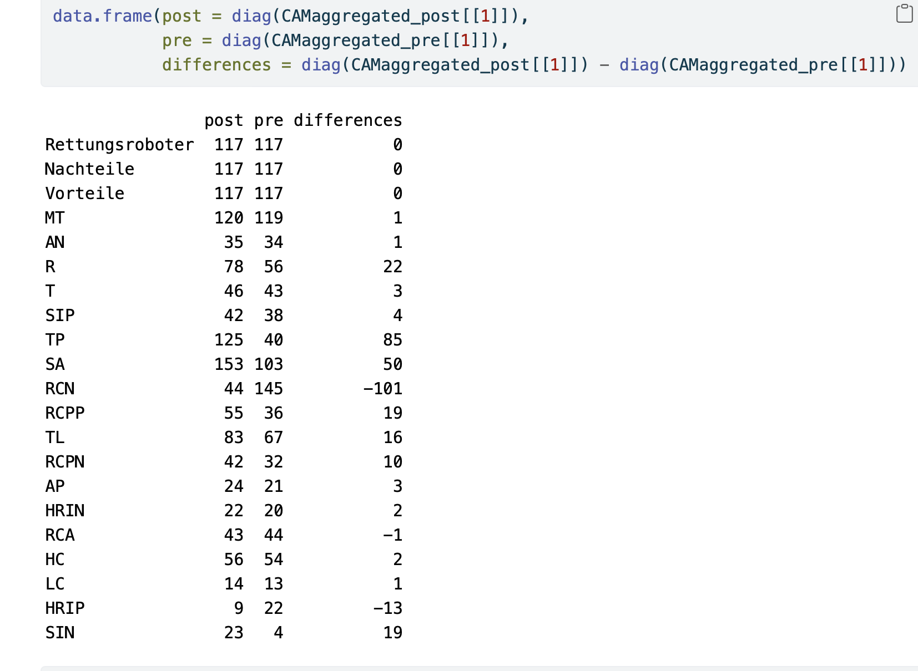
R2: Perceived risks and benefits qualitative: CAM semantic content
socially assistive robot:
rescue robot:

Slide 12
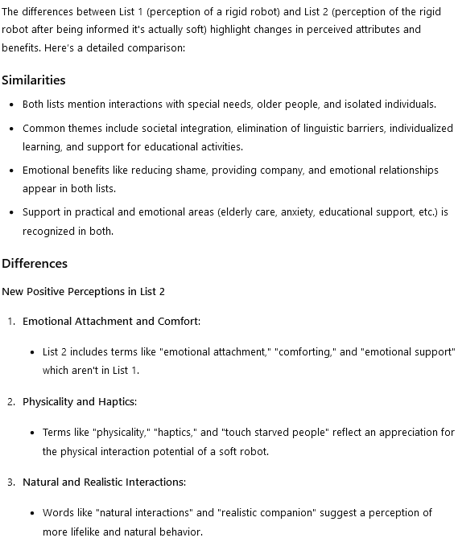
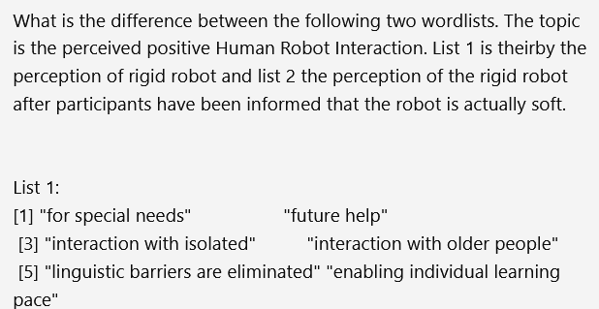
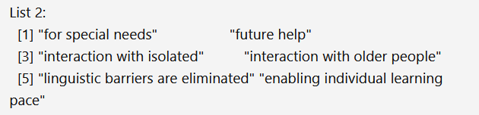
R2: Perceived risks and benefits qualitative: CAM semantic content
Output:
Input:
HRI, pos. Link: https://chatgpt.com/share/3b56c65d-4ef9-4c6d-9a0e-6819bbd20e3f

Slide 13
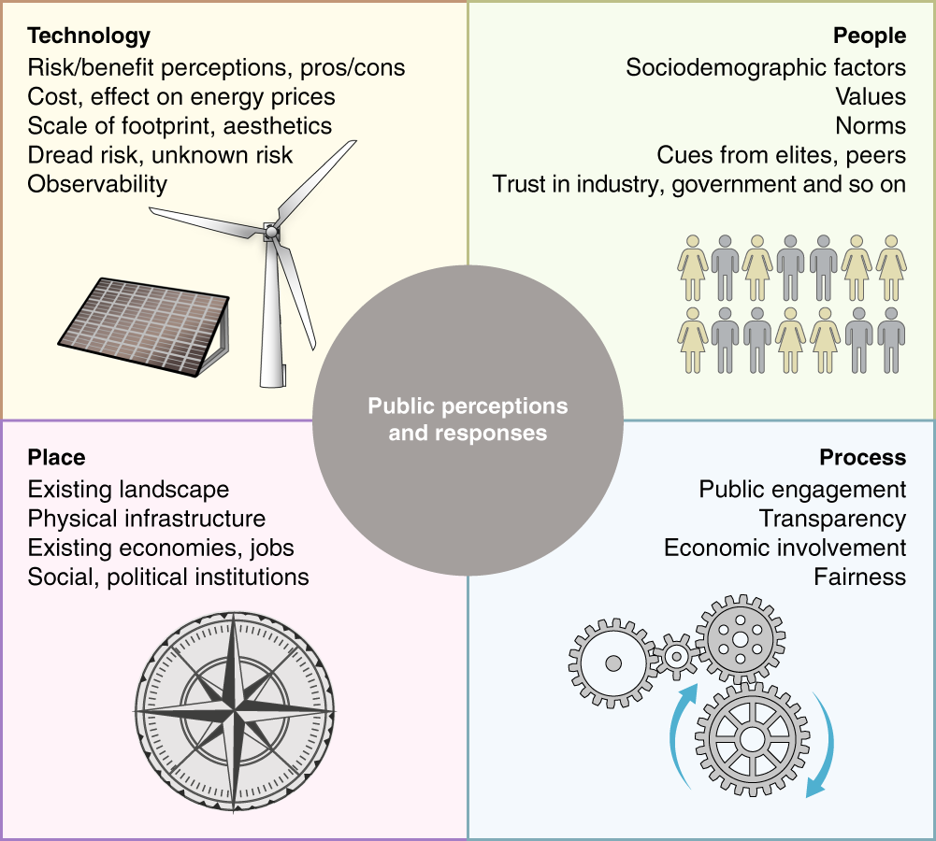
R2: Perceived risks and benefits qualitative: CAM semantic content - overview

Slide 14
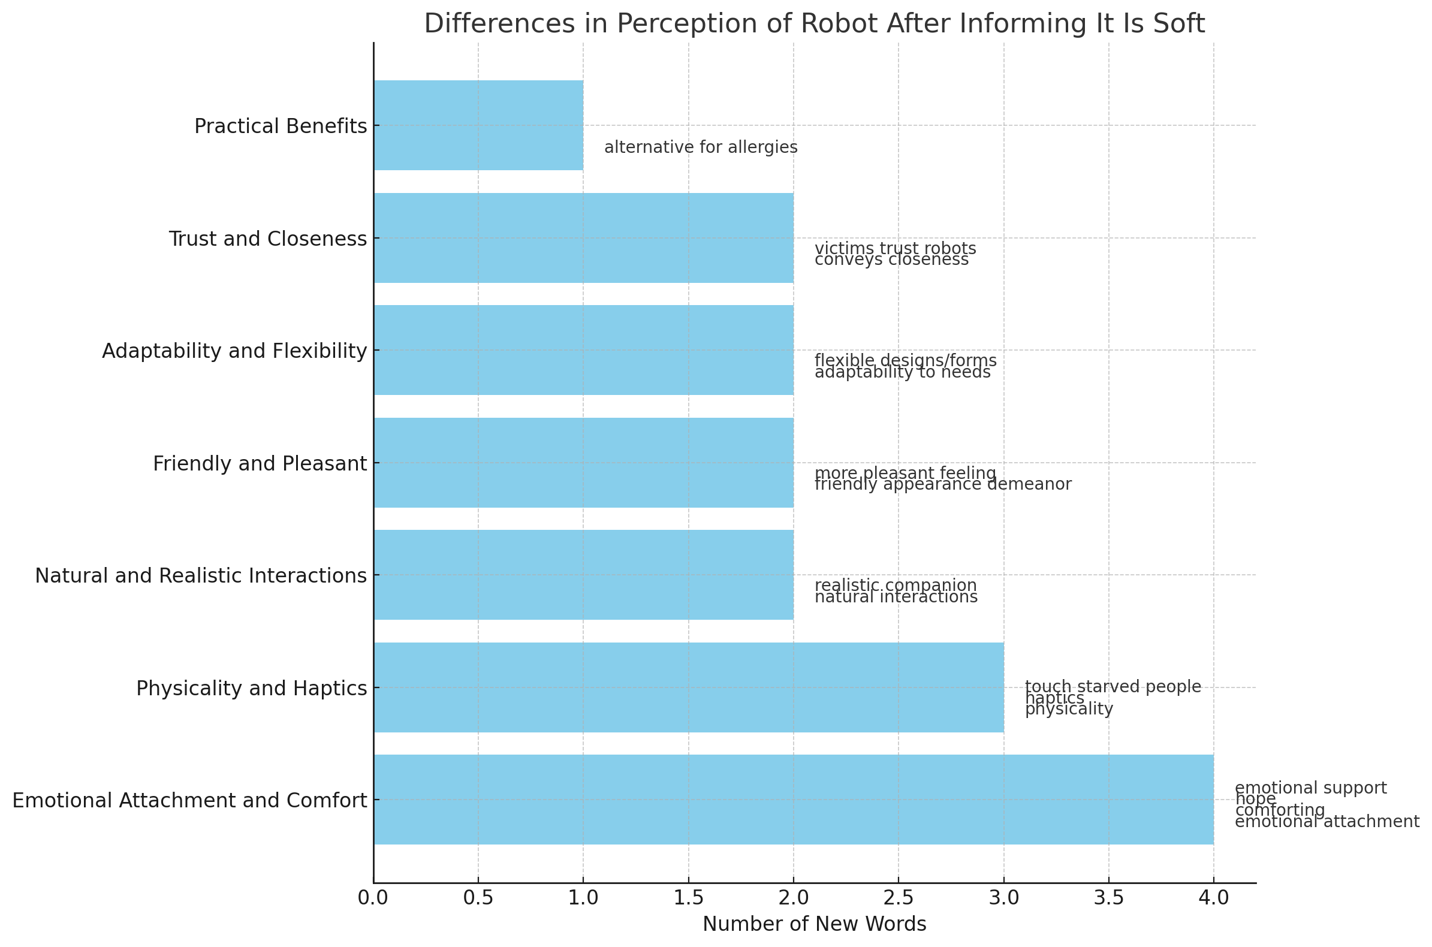
R2: Perceived risks and benefits qualitative: CAM semantic content – single topic

Slide 15
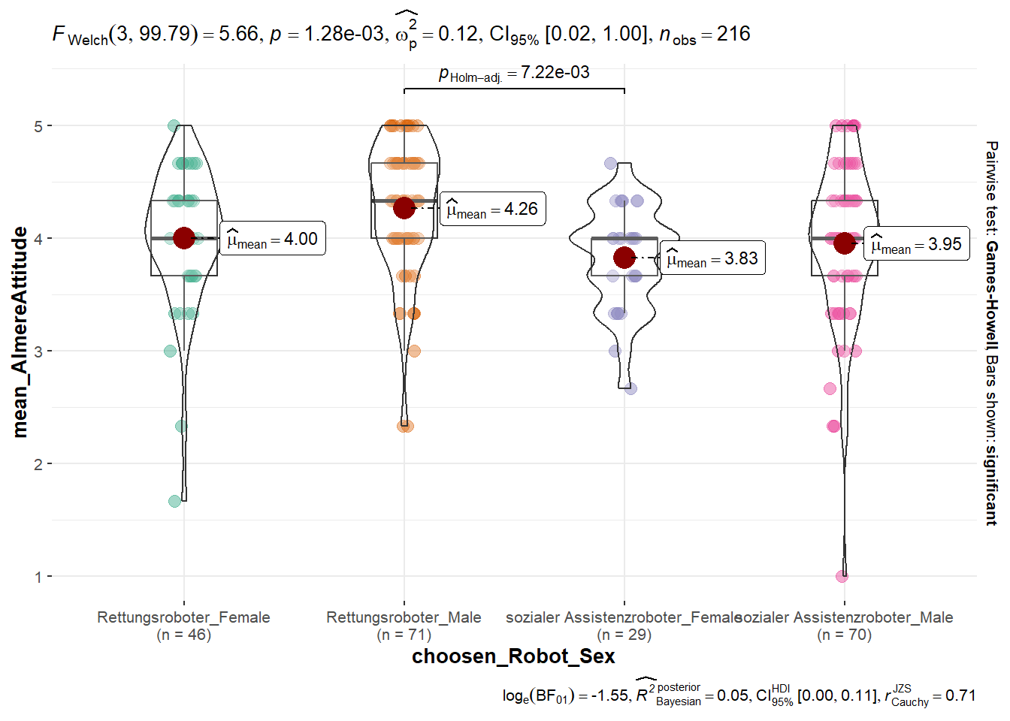
R3: Perceived risks and benefits qualitative diff. by gender: survey scales

Slide 16
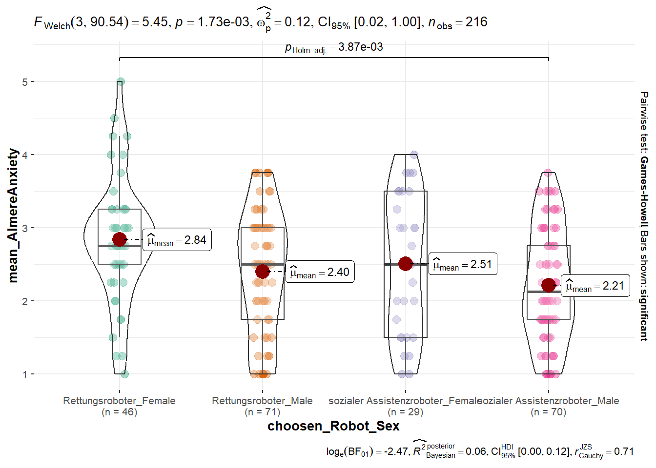
R3: Perceived risks and benefits qualitative diff. by gender: survey scales

